Slide 1
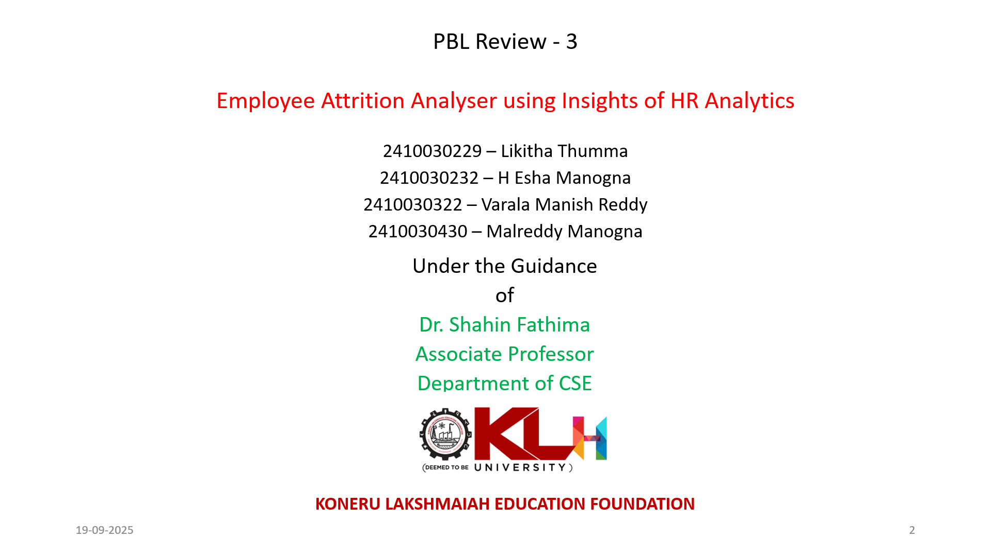

Slide 2
Employee Attrition Analysis
Insights for HR Decision-making

Slide 3
Table of contents
01
04
02
03
Hypothesis
Introduction
Literature Survey
Objectives
05
Research Gaps
Analysis
06

Slide 4
Introduction
Employee attrition occurs when employees leave the organization.
High attrition impacts costs, productivity, and team morale.
HR data provides insights into factors like:
Salary & compensation
Job satisfaction
Career growth
Work-life balance
Analysis helps HR identify key reasons for attrition.
Goal: Support data-driven strategies for employee retention.
Notes:
Employee attrition happens when employees leave an organization, and high attrition can significantly impact costs, productivity, and team morale.
By analyzing HR data, we can gain valuable insights into critical factors such as salary and compensation, job satisfaction, career growth opportunities, and work-life balance.
This analysis empowers HR teams to identify the key reasons behind attrition and take proactive, data-driven steps to improve employee retention, ensuring a stronger, more engaged workforce.

Slide 5
Objectives
To analyze HR data and understand patterns of employee attrition.
To identify key factors influencing employees to leave.
To study the relationship between job satisfaction, salary, promotion, and attrition.
To provide HR teams with insights for better retention strategies.
To support data-driven decision-making for reducing attrition.
Notes:
The main objective of this project is to analyze HR data and uncover patterns related to employee attrition.We aim to identify the key factors that influence employees to leave the organization. This includes studying the relationship between job satisfaction, salary, promotions, and attrition trends.The ultimate goal is to provide HR teams with actionable insights that can help design better retention strategies.By doing so, we support data-driven decision-making to effectively reduce attrition and improve workforce stability.

Slide 6
Methodology
Step 1: Data Collection – HR dataset of employee details.
Step 2: Data Preprocessing – cleaning, handling missing values.
Step 3: Exploratory Data Analysis (EDA) – identifying patterns & key factors.
Step 4: Hypothesis Testing – checking relationships between factors & attrition.
Step 5: Insights & Findings – summarize results to support HR strategies.

Slide 7
Results:
Data Preprocessing:
Dataset successfully loaded and explored.
No major missing values found (handled if present).
Categorical variables identified.
Numerical features scaled for consistency.
Features (X) and Target (y = Attrition) separated for analysis.
Dataset ready for further modeling and analysis.

Slide 8
Analysis:
Total records and features in the HR dataset identified.
Checked for missing values → handled/confirmed none.
Detected categorical vs numerical variables.
Removed duplicates (if any).
Prepared dataset for further analysis and modeling.

Slide 9
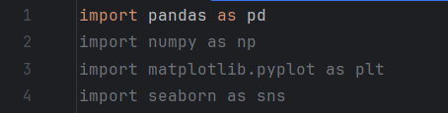
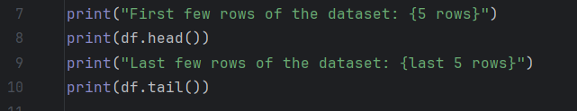
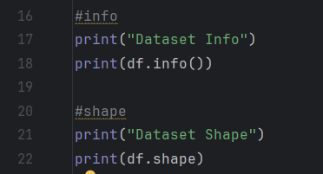
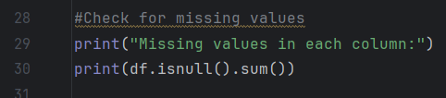
Importing necessary Libraries
Viewing the Dataset
Dataset Information
Checking for missing values

Slide 10
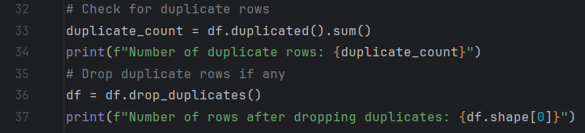
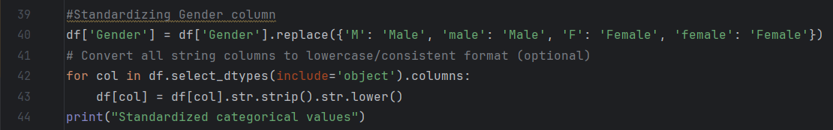
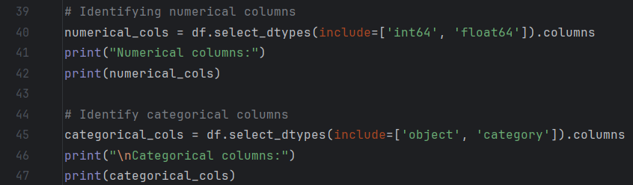
Checking For duplicate rows and dropping if any :
Standardizing Columns:

Slide 11

Thank You!

